Slide 1
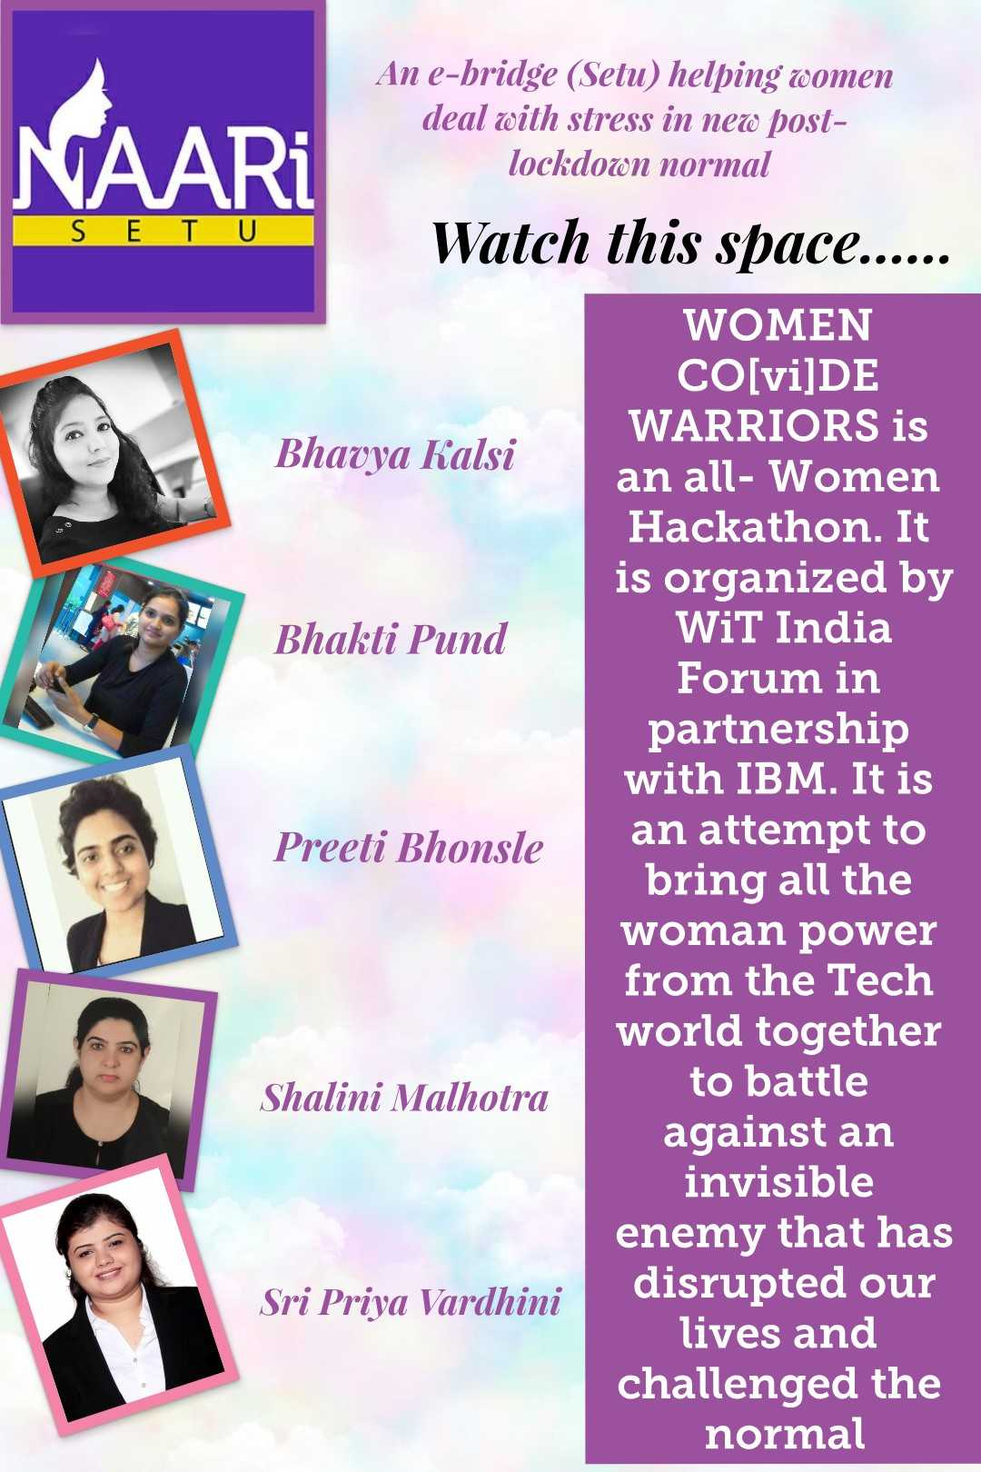

Bridge to Sustainable Womanhood

Slide 2
Executive Summary……….(1/2)
From dealing with COVID-19 to running a family, the Indian woman does it all. She works, provides for her family, makes sure that her family is safe and also works on herself to get better every day. We surveyed (Link to survey ) a group of 61 women and found out that around 90% of them feel that the amount of household work has increased substantially due to the lockdown imposed due to the pandemic. More than half of our respondents have also admitted that they are worried about their job security and are also finding it difficult to stay positive on a daily basis. Based on our survey and our personal experiences, we have identified the problem statement around the health of women and have proposed a solution to address this problem
NAARi Setu is a one stop, women- only solution that bridges women’s health with doctors, counsellors, psychiatrists, access to medicine, stress busters from all walks of life, across the nation. It is a platform that can be used by women to seek support regarding their physical and mental health. It is a culmination of counselling, telemedicine, information on health and schemes and trivia. We have built the Neena Bot to ask the right questions to identify the problem of a woman user

Slide 3
Executive Summary……….(2/2)
Neena bot will then provide the best course of action based on the analysis of the inputs received. We have enabled registration and verification of the doctors that can be listed on the portal, who can be availed for consultancy via text, video/ audio call. The payment provision for the same is also included via the online payment gateways. In order to continuously improve the portal to enhance the overall user experience, we have provided the rating scales for the doctor and the experience, along with qualitative feedback via text. We have also brought in the fun element by incorporating games like crosswords and have provided useful links for the various schemes for women carried out by the government
We envision to embed it with Indian JAM (Jandhan, Aadhar, Mobile) stack, to increase its reach and to bring a streamlined method of recourse nation-wide. We also envision to integrate supply chain for medicines and insurance provisions (DBT) like PM Ayushmaan Bharat. We can further utilize the data from wearables and health monitoring devices that can be shared with the doctor on a real time basis.
Overall, our aim is to provide a holistic and sustainable solution to women’s health which is easily accessible from any part of the world.

Slide 4
We are humbled to submit & support Women CO[vi]DE Warriors …..1/7
1. Submission name : Enter the name for your solution or team in about five words
NAARi Setu
2. Short description : Describe your team’s solution in about ten words
An e-bridge (Setu) helping women deal with stress in new normal

Slide 5
Women CO[vi]DE Warriors submission slide 2/7
3. Long description : Write about 500 words, or around one page of text, that covers the solution in more detail. Please include the real-world problem you identified, describe the technology project you created, and explain why it’s better than any existing solution. You can supply additional documentation in your source code repository.
Please double click to open on the above icon

Slide 6


Women CO[vi]DE Warriors submission slide 3/7
4. Solution Roadmap : Create a document or image that shows how mature your solution is today and how you would like to improve it in the future. This can include information on the business model, funding needs, and a sustainability plan.
Solution Roadmap
1st Month
3 Months
6 Months
Portal Launch for registration of patients and doctors. App launch on Android and ios , Onboarding State and Private Doctors
Analytics, Functionality increase, Connection with Pharmacies. App for KAios (OS for feature phones)
Connect with hardware company to enable IOT collection of data ( swabs, blood sample )

Slide 7
Women CO[vi]DE Warriors submission slide 3a/7 (Continued….)
Business Model
Hybrid business model is envisioned. The state would provide state based women doctors, gynecologist , mental health professionals free of cost. There would be private doctors also which could be subscribed with a limited fee and subscription structure. (The fee and subscription structure is being thought about)
Funding Needs
Activities | Cost needs (INR)
Development needs (Team of 5 for 1 month) | 1,220,000
Infrastructure Needs | 350,000
Marketing Needs | 100,000
Legal Needs for telemedicine guidelines and disclaimers | 50,000
Total | 17,20,000 ( Approx. $ 25,000)
Sustained Platform Need – Post Launch
Activities | Cost needs (INR)
2 People support 9x5 for the year | 3,00,000

Slide 8
Women CO[vi]DE Warriors submission slide 3b/7 (Continued….)
4. Solution Roadmap : Create a document or image that shows how mature your solution is today and how you would like to improve it in the future. This can include information on the business model, funding needs, and a sustainability plan.
Sustainability Roadmap
Laws of Tele-medicine: Adherence to telemedicine guidelines by the government
Constant Innovation : Constantly innovating for the new solutions and using the ecosystem like Atal Innovation center for team growth
Small efficient team : Team involved and responsible for energy efficiency
Change Policies: Change policies implementation to align to sustainability plan

Slide 9
Women CO[vi]D Warriors submission slide 4/7
5. Link to publicly accessible GitHub repository : (or other location such as GitLab or Box) where the judges can download, examine, and evaluate the source code behind the solution. You can provide additional descriptions and diagrams in the repository.
https://join.slack.com/share/zt-ew0o0o39-Dg6bb70Ix8IHMOjTbkhByA
https://github.com/BK00463636/WiT-NAARi-Setu.git
https://github.com/bp00347640/WiT-NAARi-Setu

Slide 10
Women CO[vi]D Warriors submission slide 5/7
6. Link to a three-minute demo video : Record a demo of your project, upload it to YouTube or Vimeo and share the URL. Three minutes is the maximum length. You can link to longer versions from your source code repository. Keep in mind that non-technical judges may rely on this more than technical documentation.
NAARi-Setu Walk Through on Youtube Link

Slide 11
Women CO[vi]D Warriors submission slide 6/7
7. List of one or more IBM Cloud Services or IBM Systems used in the solution. Your application can use additional data sets, libraries, and externally-hosted services to complement the IBM Cloud services or IBM Systems.
Cloud Foundry App
Runtime: ASP.NET Core

Slide 12
Women CO[vi]D Warriors submission slide 7/7
8. Your email address and the email addresses of up to four additional team members. Each team member needs to be registered. You can only be part of one team of up to 5 members, and your team can only submit one application.
Bhavya Kalsi: BK00463636@TechMahindra.com (Registered Commander)
Bhakti Shrikant Pund : BP00347640@TechMahindra.com
Preeti Bhonsle: Preeti.Bhonsle@TechMahindra.com
Shalini Malhotra: sethshalini@hotmail.com
Sri Priya Vardhini: NV00556385@TechMahindra.com

Slide 13
References
https://www.everyoneok.be
https://www.therapyinindia.com
https://iwill.epsycinic.com
https://yourdost.com
https://www.weforum.org/agenda/2020/04/this-is-the-psychological-side-of-the-covid-19-pandemic-that-were-ignoring/
https://www.thehindu.com/society/isolation-and-mental-health-the-psychological-impact-of-lockdown/article31237956.ece

Slide 14
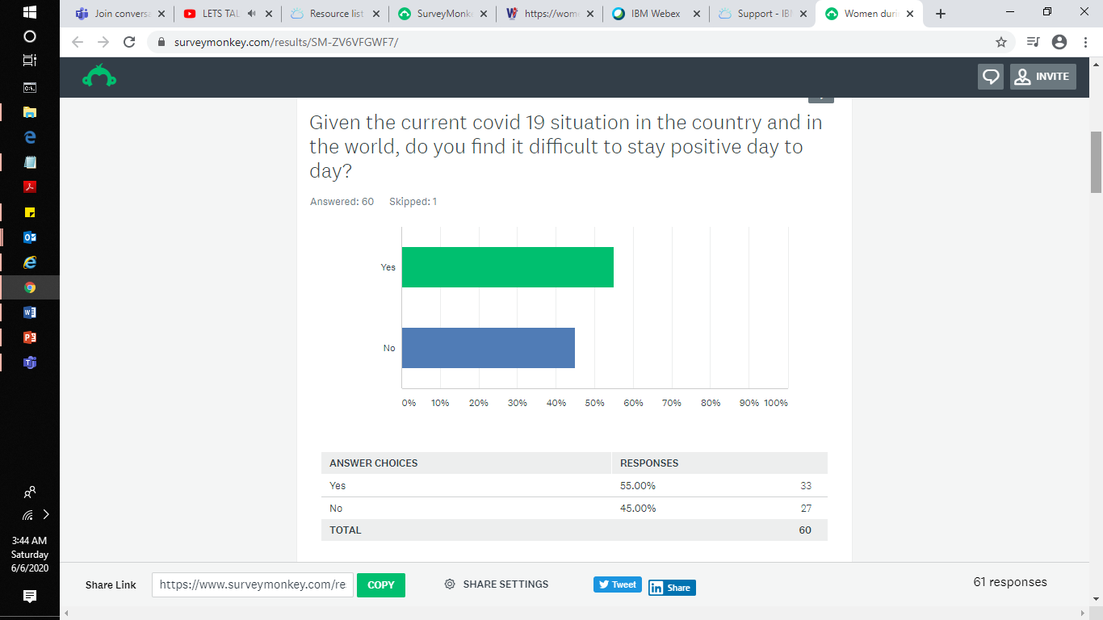
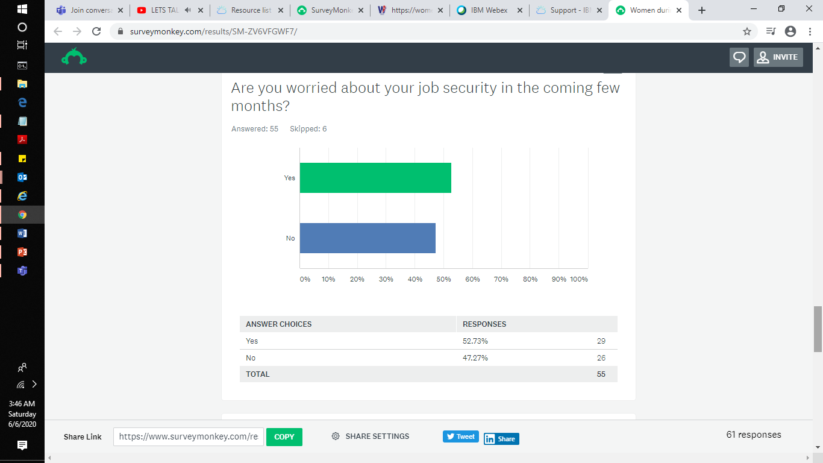
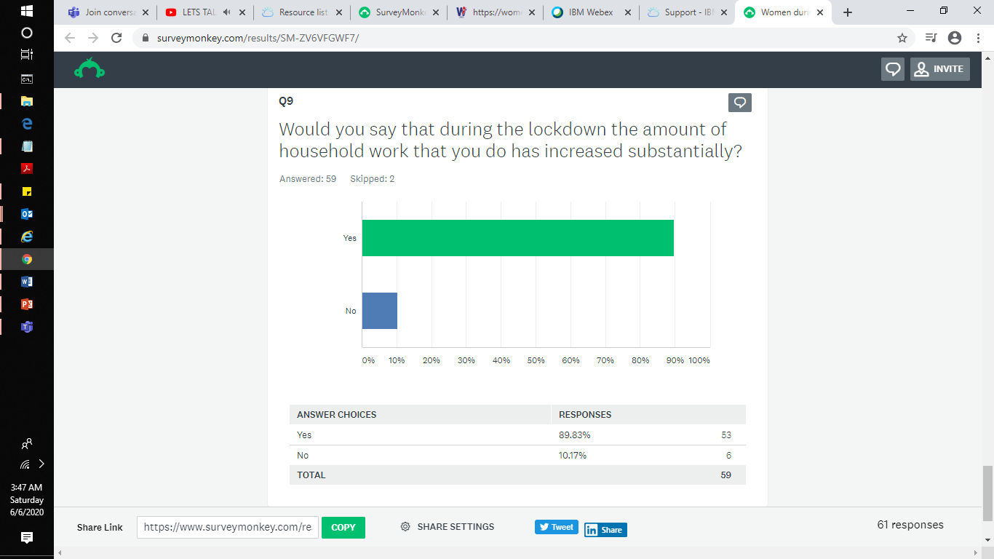

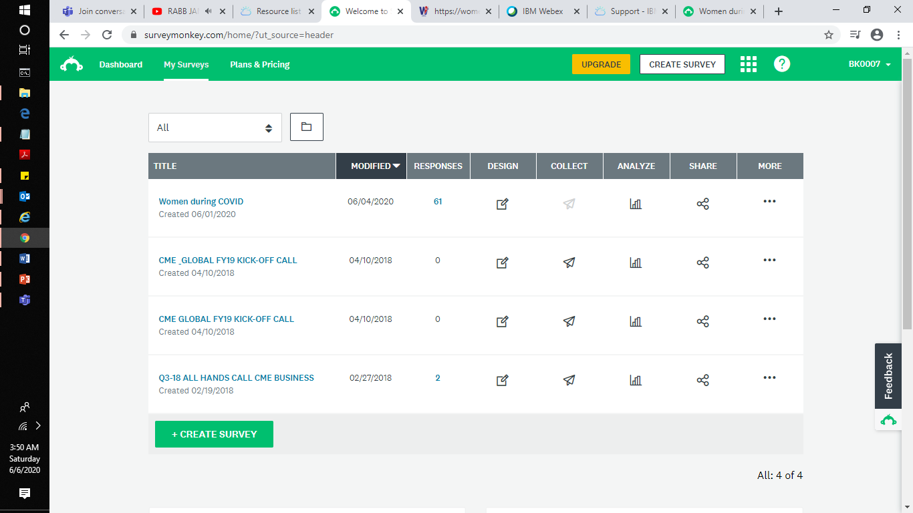
How did we conduct survey for NAARi Setu…..
https://www.surveymonkey.com/results/SM-ZV6VFGWF7/

Slide 15

Watch this space for more….
If you wish to connect with us.. Write to Bhavya Kalsi

